Slide 1
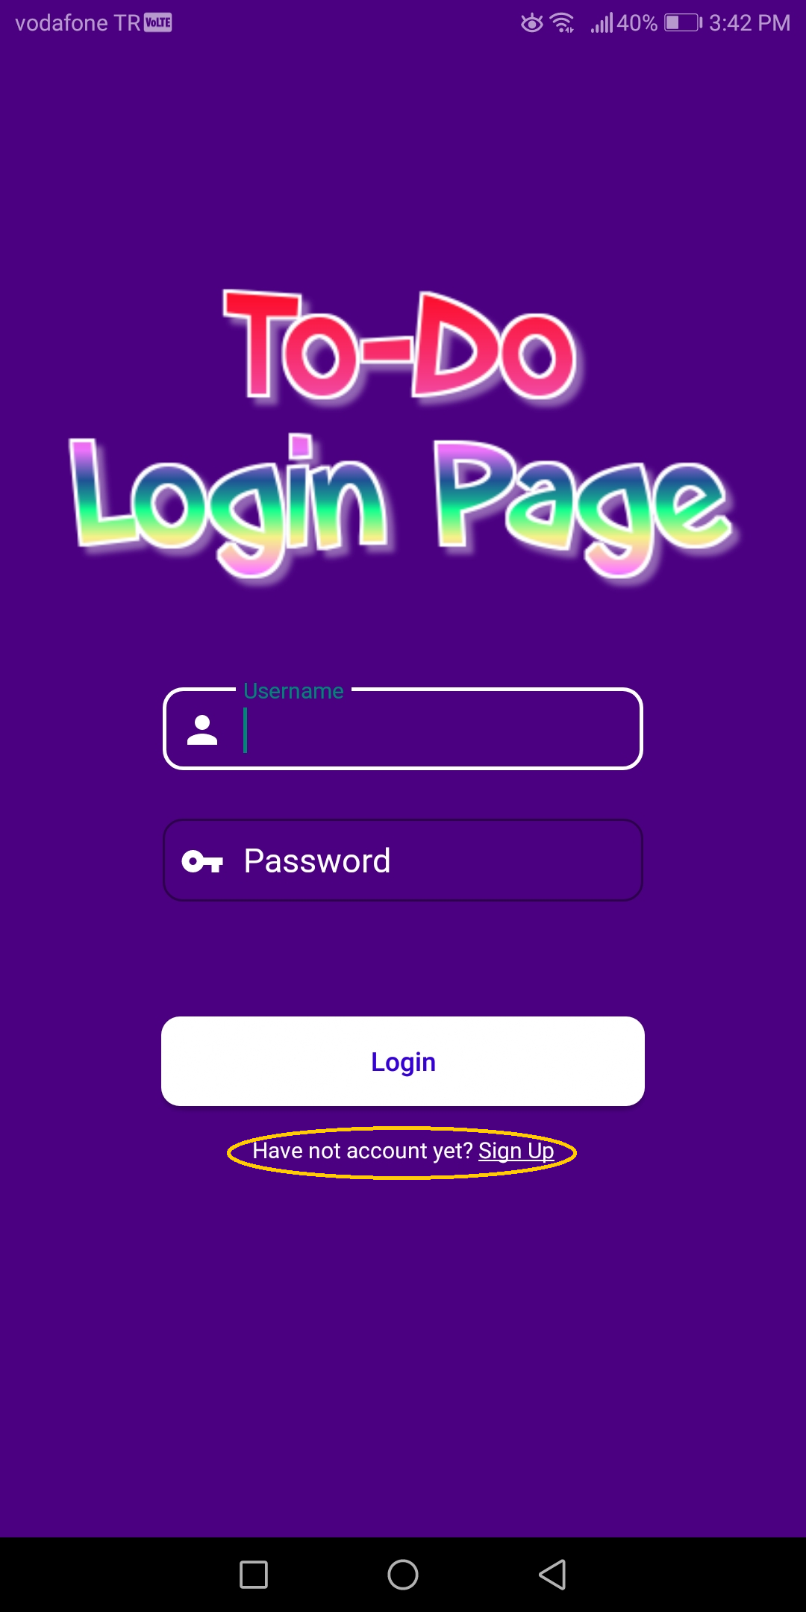
If you have not an account , You have to sign up. Click here to sign up
I

Slide 2
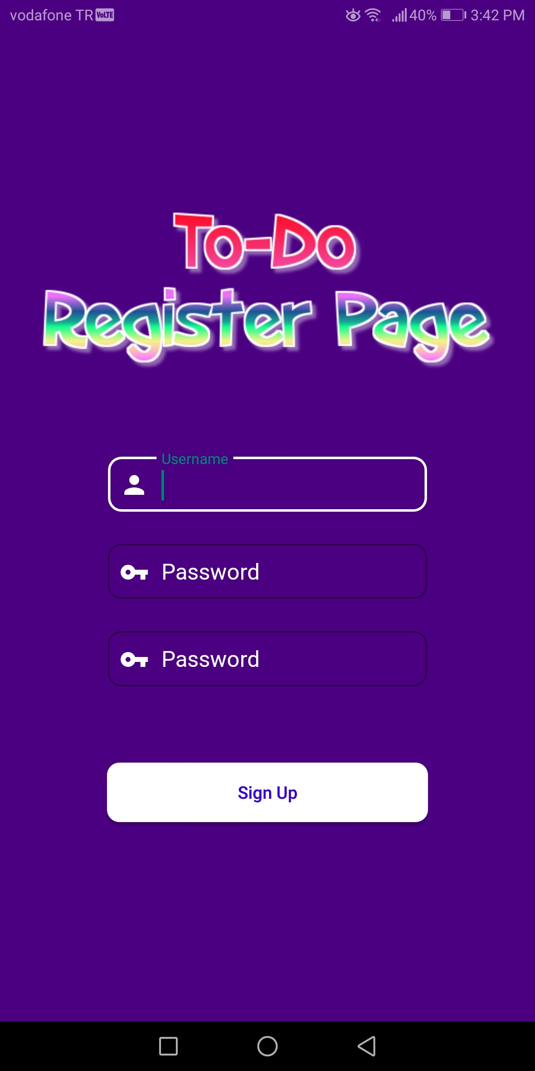
You can sign up at this page.

Slide 3
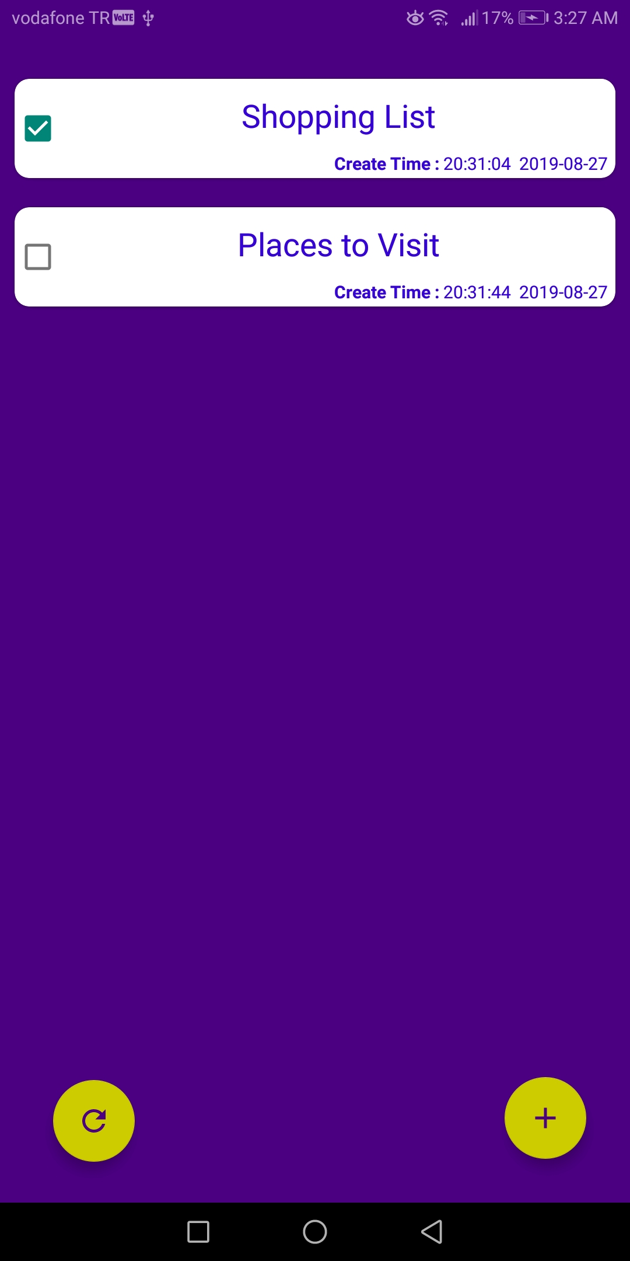
After sign in this page will be open. You can add new To-Do list items from the yellow button in the right corner. If you want to delete your To-Do list item swipe it. It doesn’t matter right or left.
You can not click these checkboxs because its unclickable. When To-Do items completed all , the checkboxes will be clicked. (You should click refresh button in the left corner for To-Do list item completed.)

Slide 4
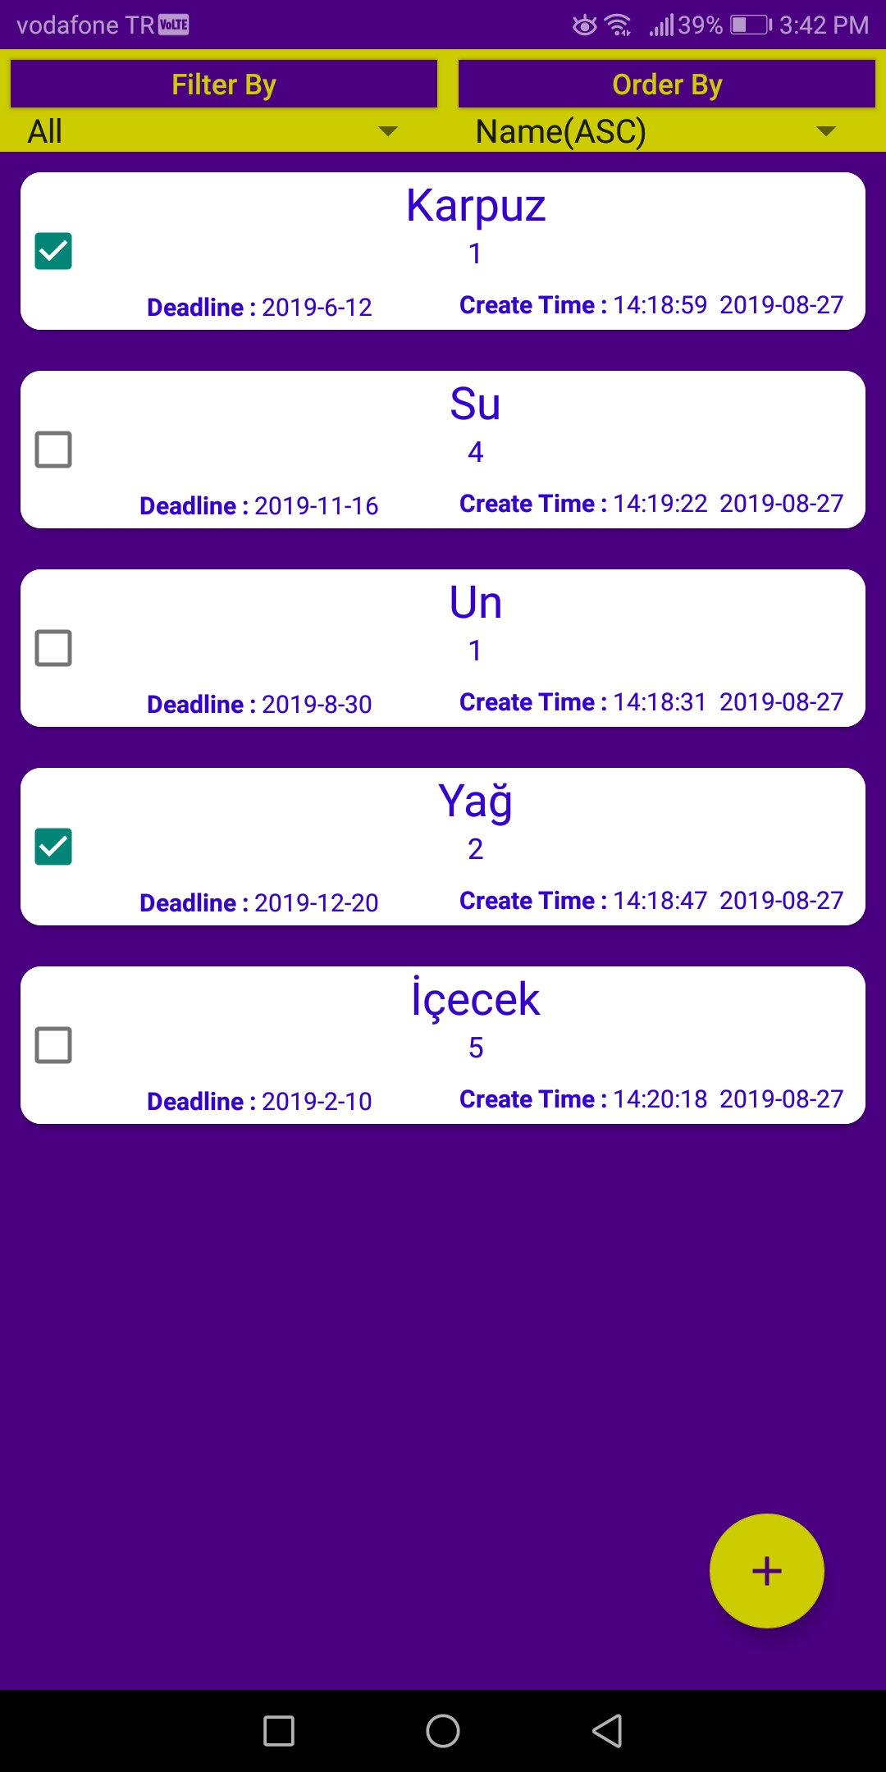
After click To-Do list item this page will be open. You can add new To-Do items from the yellow button in the right corner. If item completed , you should click checkbox at left side of the item.
If you want to delete your To-Do item swipe it.It doesn’t matter right or left.

Slide 5
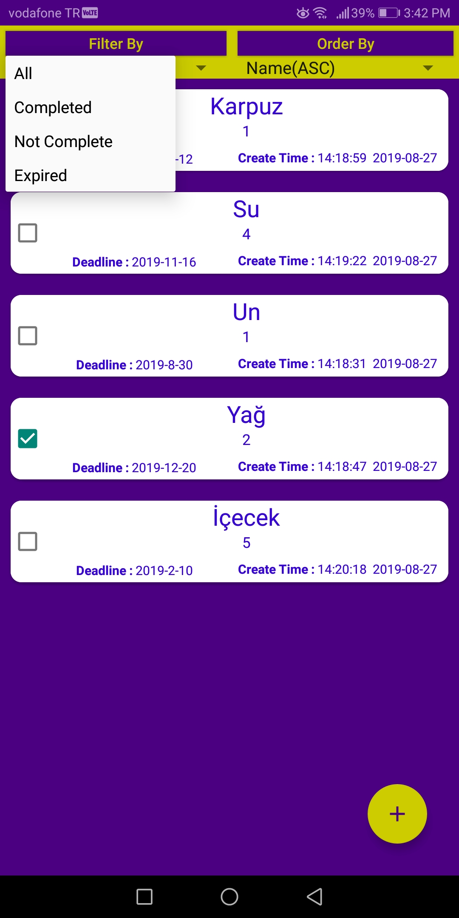
You can filter your To-Do items from spinner at left corner.

Slide 6
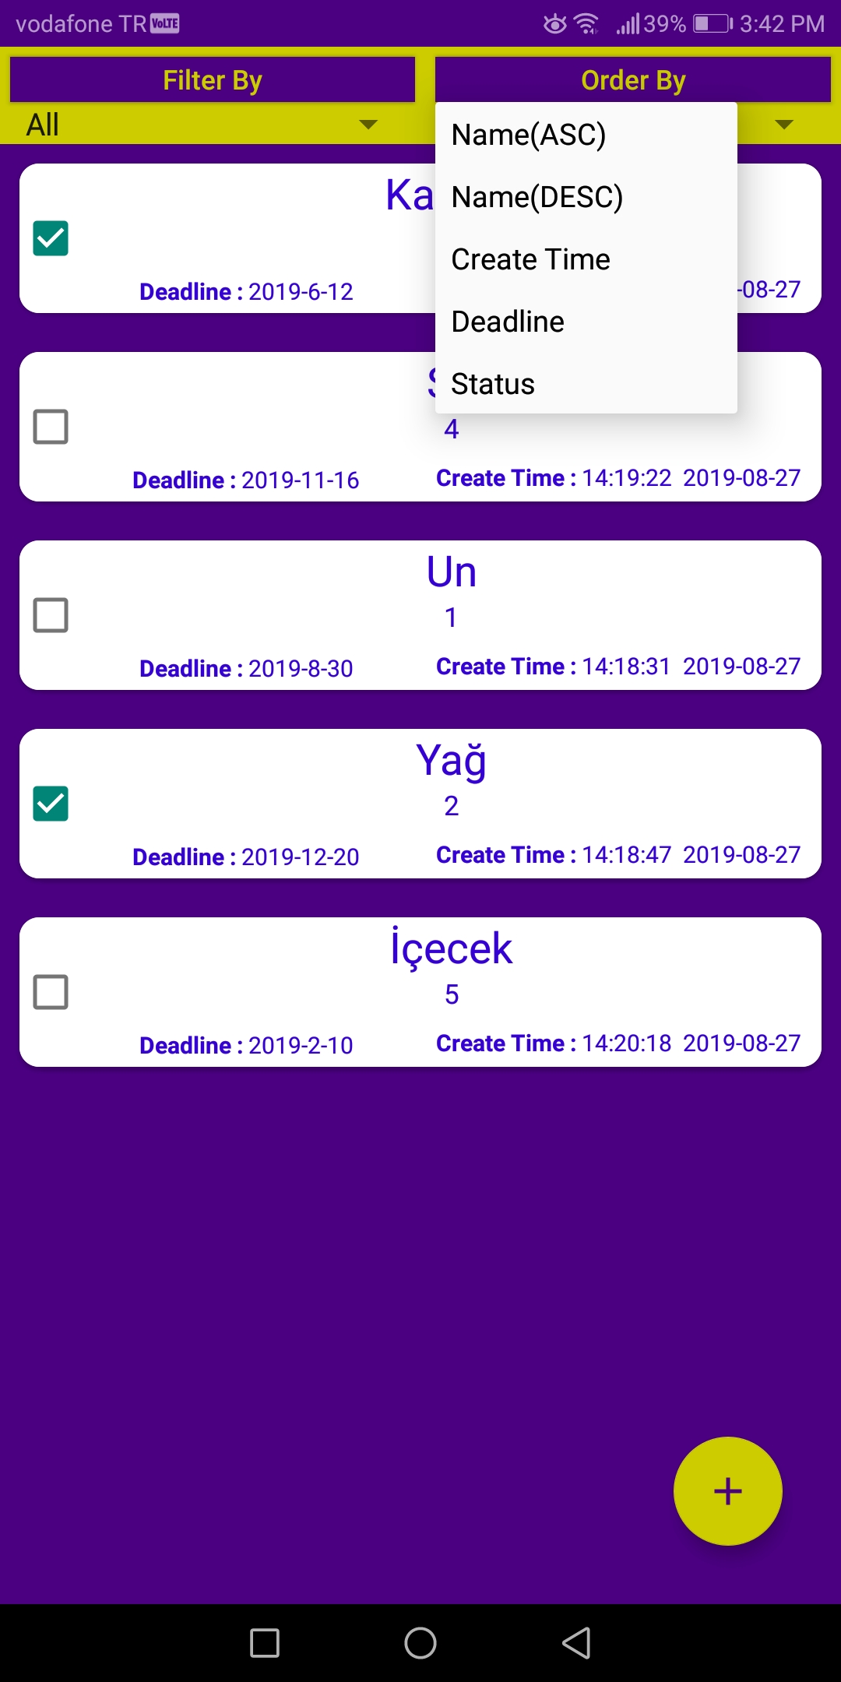
You can order your To-Do items from spinner at right corner.

